Slide 1

SHREE RAMSWAROOP MEMORIAL UNIVERSITY
Assignment:-5
Java Enterprise Edition Lab - 05
Submitted to:
Submitted by:
Vidushi Srivastava
Mukesh Prajapati
Btech (Cse Industry integrated)
Roll No – 202410101230007

Slide 2
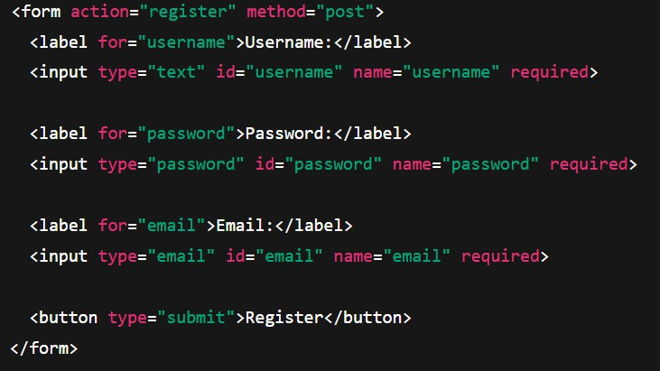
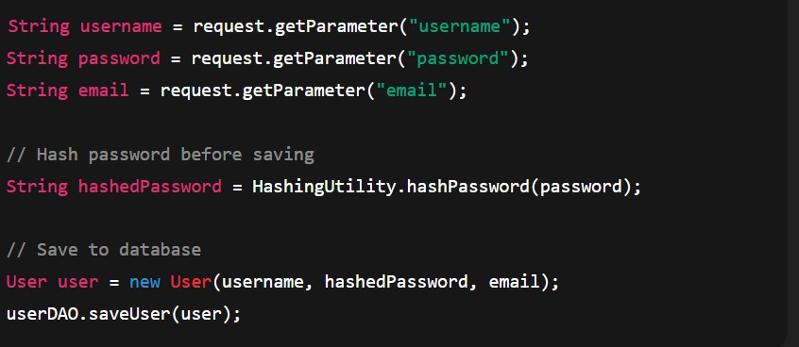
Step 1: Designing the User Registration System
1.1 Create the Registration Form
The HTML form collects username, password, and email.
1.2 Processing Registration Data in Servlet
The servlet handles form submission, hashes the password, and saves user data.

Slide 3
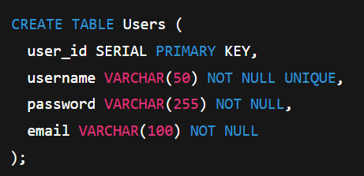
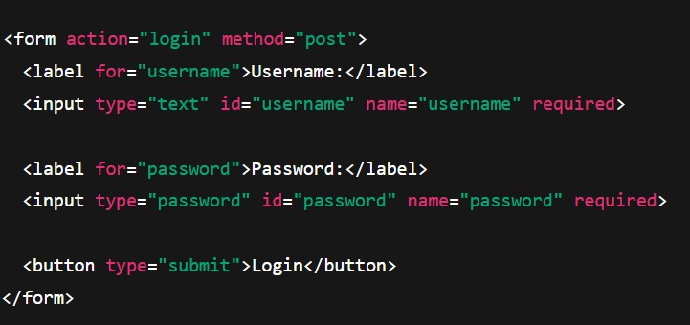
1.3 Database Table for Users
Create a table in PostgreSQL (or MySQL) to store credentials securely.
Step 2: Implementing User Login System
2.1 Create the Login Form
HTML form for user login.

Slide 4

2.2 Authenticating User Credentials in Servlet
The servlet compares hashed passwords securely.
String username = request.getParameter("username"); String password = request.getParameter("password");
User user = userDAO.getUserByUsername(username);
if (user != null && HashingUtility.verifyPassword(password, user.getPassword())) {
// Successful login
request.getSession().setAttribute("user", user); response.sendRedirect("dashboard");
} else {
// Login failed
response.sendRedirect("login?error=true");
}
Step 3: Managing User Sessions
3.1 Creating a Session
Upon successful login, a session is created.

Slide 5
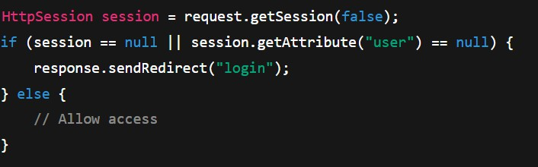
3.2 Protecting Sensitive Pages
Check session before allowing access to dashboard or profile.

